Slide 1
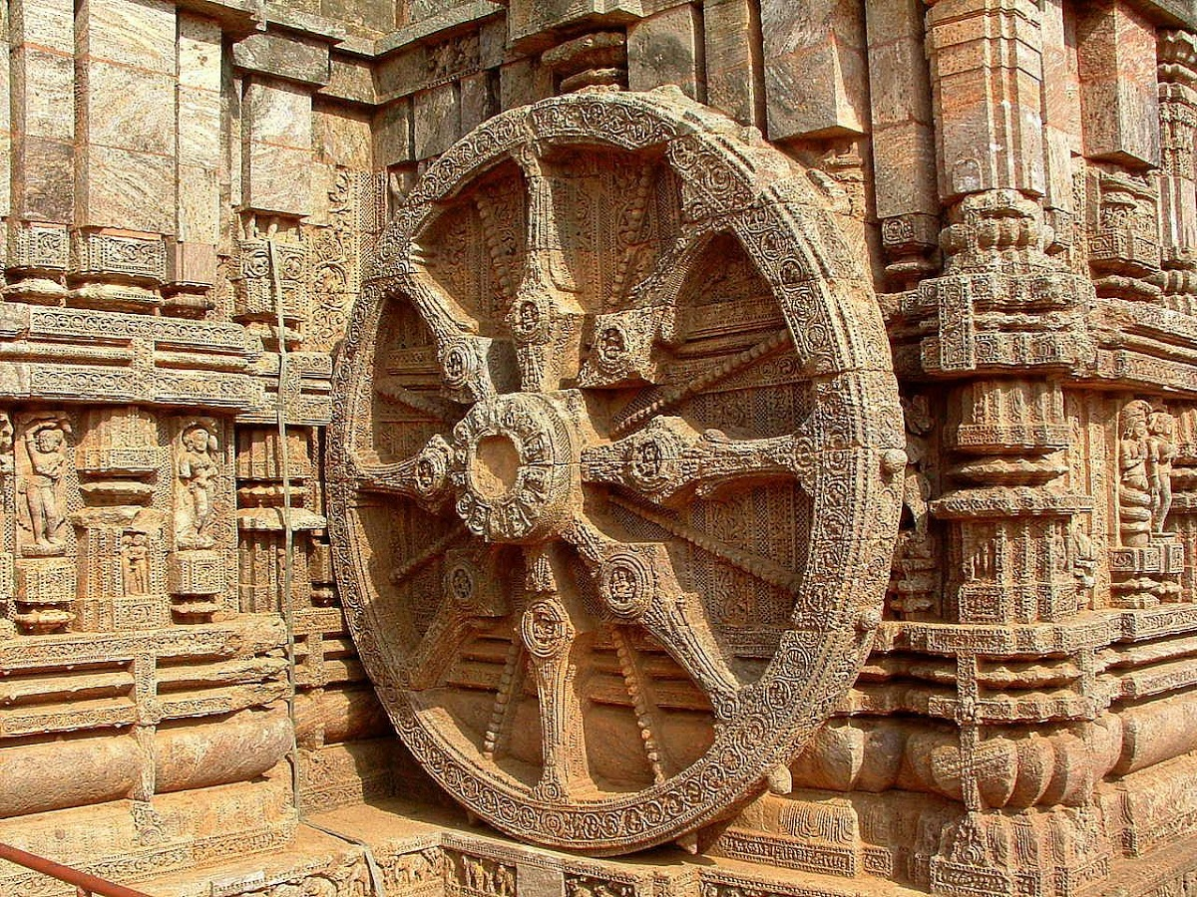
Department of History
Jesus and Mary College
University of Delhi
2015-2018

Slide 2
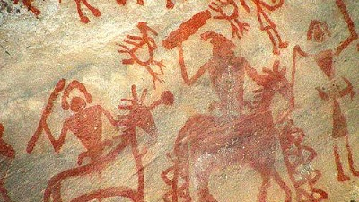
OUR VISION
The Department of History strives to inculcate critical thinking, creativity and scientific temper among students. The students are encouraged to think rationally, free from communal biases, caste prejudices, be gender sensitive and appreciate regional diversity. In keeping with the spirit of the discipline, they are also encouraged to analyze historical contexts and their social, political and economic aspects. The faculty aims to add value to classroom teaching by involving students in innovative projects related to developing skills for history-writing. The ultimate aim of the department is to create socially and politically responsible citizens for tomorrow.

Slide 3
Department PROFILE
The Department of History was established in 1968 as part of B.A. (Prog). The Honours course in History was started in 1982. The total faculty strength at present is 8.
Courses are offered in B.A. Hons History, B.A. Programme, B. El. Ed., inter-disciplinary and Generic Elective courses and a course in lieu of Modern Indian Language to other departments.
Total number of students taught by the department:
History (Hons) | 146
B.A. Prog | 190
B.El.Ed. | 32
Interdisciplinary and Generic Elective Courses | 100

Slide 4
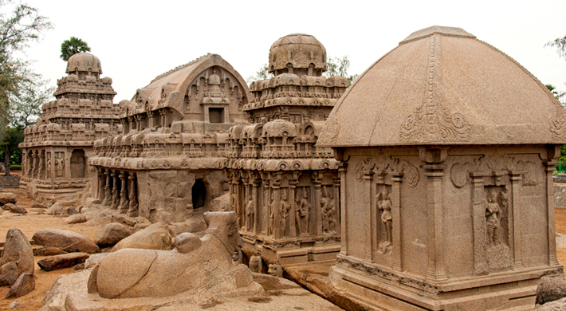
FACULTY PROFILE
Name | Qualification | Designation | Specialization | Experience
Ms Ghazala Amin | B.A., M.A. | Associate Professor | History of Modern India (Modern Europe, Journalism/Media Studies) | 28
Dr Nilima Chitgopekar | B.A, M.A., Ph.D. | Associate Professor | History of Ancient India (History of religion, Hinduism, Gender and Tantric traditions etc) | 35
Dr (Sr) Molly Abraham | B.A., M.A., Ph.D. | Assistant Professor | History of Modern India (Modern World; History of Women and Missionary Education) | 17
Dr Saumya Varghese | B.A., M.A., M.Phil., Ph.D. | Assistant Professor | History of Medieval India (Trade and Urbanization, Identity Formation; History of South East Asia, USSR, World) | 7

Slide 5
FACULTY PROFILE
Name | Qualification | Designation | Specialisation | Experience
Dr Amita Paliwal | B.A., M.A., NET, Ph.D., | Assistant Professor | History of Medieval India (Medieval Economic and Administrative History, Diplomats-Study of Documents, Modern Delhi, Environmental issues) | 15
Dr Richa Raj | B.A., M.A., M.Phil., NET, Ph.D. | Assistant Professor | History of Modern India (Communalism, Nationalism, Women’s Studies, Education, Rise of Modern West) | 8
Dr Maya John | B.A., M.A., NET, Ph.D. | Assistant Professor | History of Modern India (Labour Laws, Social Movts, Caste and Women Studies, Modern European History ) | 4+
Dr M. Christhu Doss | B.A., M.A., M.Phil., Ph.D. | Assistant Professor | History of Modern India (Education, Missionary Politics, Gender and Caste, Secularism and Communalism) | 3

Slide 6
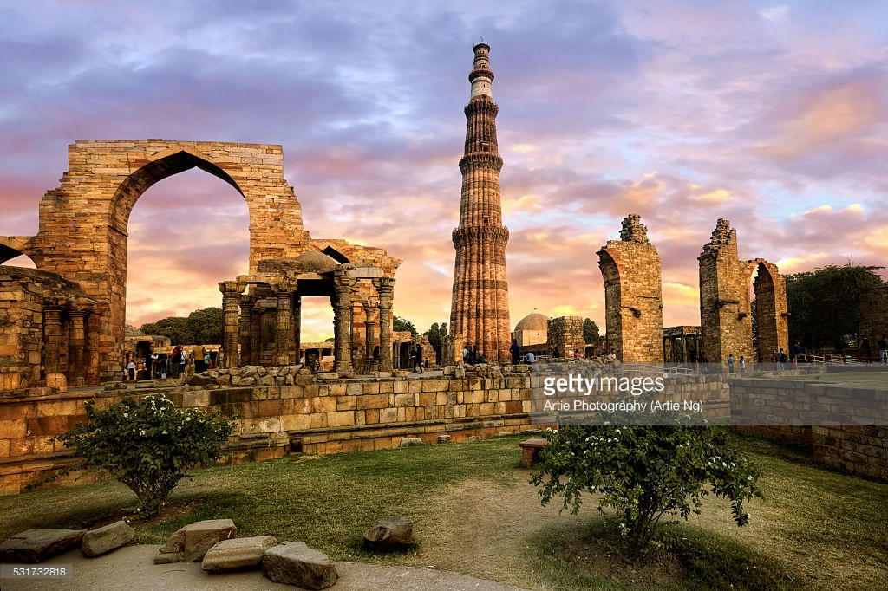
FACULTY ‘S ACADEMIC PROGRESSION
Conferences/Seminars/Workshops | Research Publications/Books/ Chapters/Articles | Media
Paper Presentations: International: 25 | Research Articles (Journal/Proceedings): 11 | Talks delivered on Television: 2
Paper presentations: National: 28 | Chapters in Books: 2 | CEC-EDUSAT Lecture Series: 4
Presentation at Workshop: 1 | E-content: 3 | Docu-series: 2 episodes
Workshop/Training Prog. attended: 9 | Newspaper/online: 3
Chair: 2 Discussant: 3

Slide 7
National and international projects
Research grants under the Innovation Project scheme of the University of Delhi were applied for in August 2017. Topics of proposed innovation projects are:
Oral History of the Settlement of Urban Poor in Delhi, by Dr Saumya Varghese and Dr Maya John
Gender, Military, Culture: Begum Sumroo’s Political and Cultural Interventions in Delhi and Its Suburbs, by Dr Amita Paliwal and Dr Richa Raj

Slide 8
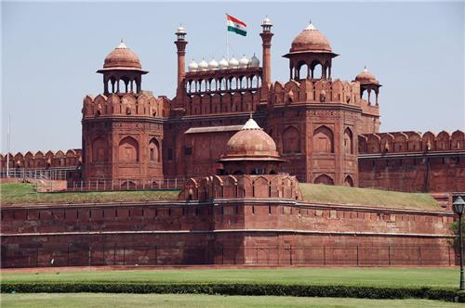
Achievements/awards/recognition
Name | Committees/ Editorial Boards | College-level Administrative Tasks | University Assignments
Ms Ghazala Amin | On Leave | On Leave | On Leave
Dr Nilima Chitgopekar | IQAC | Convenor: Western Music Society
Dr (Sr) Molly Abraham | Member, Editorial Board: Journal of Research: Bede Acteneum; Internal Assessment Committee, IQAC | Member, Governing Body; Member, AICUF; Co-coordinator, B.VOC; Co-ordinator IGNOU; Member North-East Society | Question paper Setting
Dr Saumya Varghese | B.A. Prog. Admission Committee; PTSA | Member, Governing Body; Convenor, UGC Coaching for Civil Services for SC/ST/OBC/Minority; Member AICUF; Secretary, Staff Association; Convocation | Question paper Setting

Slide 9
Achievements/awards/recognition
Name | Committees/ Editorial Boards | College-level Administrative Tasks | University Assignments
Dr Amita Paliwal | ECA Committee | Convenor: Mudra, Students’ Council; Convenor, Dastaan: Art and Architecture Society
Dr Richa Raj | Discipline Committee; B.A. Prog Admission Committee | Convenor, UGC Coaching for Civil Services for SC/ST/OBC/Minority; Caretaker National Cadet Corps; PTSA; Convocation; History Association | Member, Academic Council
Dr Maya John | Member, Editorial Board: The JMC Review; Member, Internal Complaints Committee | Convenor: WSC; Secretary Staff Association; Member, Research Committee; Convenor, Film Appreciation Society | Question Paper Setting; B.El.Ed. Course Revision
Dr M. Christhu Doss |  | Member, AICUF | Question Paper Setting

Slide 10
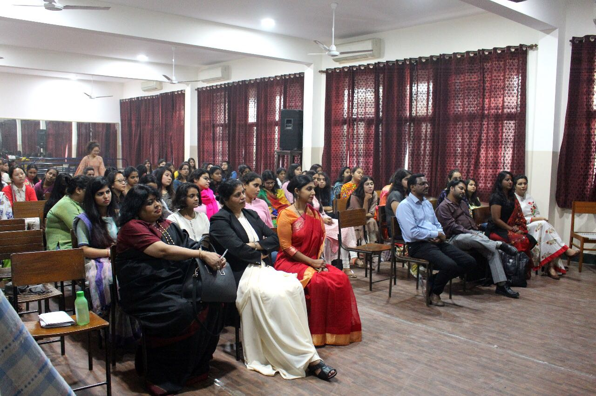
VISITS TO THE DEPARTMENT (by eminent academicians and resource persons)
2015-16
Prof. Amar Farooqui, Department of History, University of Delhi, ‘Delhi: From Backwater to Imperial Capital’, 2015
Prof. Seema Alavi, Department of History, University of Delhi, ‘Muslim Cosmopolitanism in the Age of Empire’
Prof. Tim Allender, University of Sydney, ‘Religious Orders in Colonial India: the Paradigm of Piety and Future Transformations, 1880-1935’, 1 October 2015
Prof. Mary John, Centre for Women’s Development Studies, ‘Who’s Afraid of Indian Feminism? Some Historical Reflection’, 8 October 2015

Slide 11
VISITS TO THE DEPARTMENT (by eminent academicians and resource persons)
2016-17
Dr. Sonali Gupta, ‘Egyptian Archaeology’, 14 August 2016
Prof. Stefan Berger, Director, Institute for Social Movements, Ruhr University, Germany, ‘Continuities and Discontinuities in National(ist) Historiographies in Europe from the Second World War until today’, 2 March 2017
Prof. Nira Gupta, Department of English, Kean University, New Jersey, ‘Remembering the Ladies: Women in Colonial America’
Prof. Ranjini Mazumdar, Cinema Studies, Jawaharlal Nehru University, ‘Women in Cinema: Old and New Experiences’, 19 October 2016

Slide 12
VISITS TO THE DEPARTMENT (by eminent academicians and resource persons)
2017-18
Prof. Mridula Mukherjee, formerly at Centre for Historical Studies, Jawaharlal Nehru University, ‘Making of Indian Nationalism: From Champaran to Quit India Movement’, 28 August 2017
Prof. Sucheta Mahajan, Centre for Historical Studies, Jawaharlal Nehru University, ‘Memory and Dialogue: Women’s Experiences and the Partition’, 9 November 2017
Prof. Achin Vanaik, ‘Communalism and Nationalism in post-Independence India, 22 February 2018

Slide 13
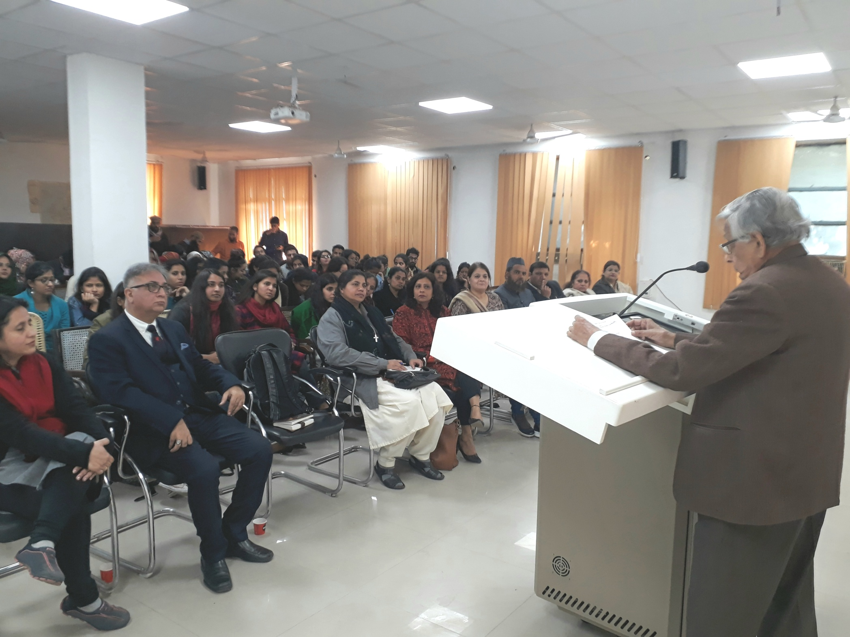
Innovative teaching methods
Student presentations/ Discussions/ Quiz
Power point presentations
Field trips to Biodiversity parks, visits to ASI and the National Museum
Maintenance of a History blog
Creating an Oral History Archive, a first of it’s kind in the college
Organising Students’ Seminar on Oral History inviting students from JMC and other colleges
Visits to universities such as Aligarh Muslim University for workshop on trends in history writing
Visits to JNU, IIC and other academic centres for attending book launches and discussions

Slide 14
Alumni report
The Department of History has approximately 135 student alumni, who completed the History Hons course from JMC between 2015 and 2017. Below is relevant information on about 25 students who have responded to the department’s questionnaire circulated in February-March 2018:
A. Career Progression
1. Number of alumni pursuing/completed higher studies: 19
2. Post-graduate institutions where our alumni are enrolled:
Delhi Institute of Heritage Research and Management
IGNOU
JamiaMillia Islamia
JawaharLal Nehru University
Mizoram University
NIFT, Delhi
SOAS, University of London
University of Edinburg
University of Delhi
University of Sheffield
3. Post-graduate courses our alumni have enrolled in:
MA History
MA in Human Rights
MA in Conservation, Preservation and Heritage Management
M.Phil in History
M.Phil in Political Science
Fashion Enterprise and Business Management
PhD

Slide 15
Alumni report
4. Number of alumni pursuing a part-time/full-time job: 7
5. Number of alumni preparing for competitive examinations (state service): 2
6. Number of students participating in community service: 3
B. Student Diversity
1. Number of out-station students: 4
2. Number of students from the North-East: 1
3. Number of students from SC/ST/OBC/PWD categories: 2
4. Number of students from Regional Boards (Senior Secondary): NIL
5. Number of students from: (a) CBSE: 19 (b) ICSE: 4
6. Number of students from non-creamy layer: 1
7. Number of students with rural/semi-urban hometown: 3

Slide 16
Department meetings/activities/events
2015-2016
Department meeting in July 2015 for Election of President and Vice President. Prerna Nair and Aishwarya Prakash were elected as President and Vice President respectively.
Department Freshers’ Day, with Tavleen Kaur being given the title of ‘Miss History’
Teacher’s Day Celebration, 5 September 2015
Department meeting for Chronicle 2015
Chronicle, the department festival, 8 October 2015 (Talk by Prof. Mary E. John; Ad Mad; Quiz; Kathakali performance, an adaptation of Shakespeare’s play Othello; Sansad: mock-parliament on the topic, Women Reservation Bill)

Slide 17
Department meetings/activities/events
2016-2017
Department Meeting in July 2016 for Election of President and Vice President. Aishwarya Prakash and Shilpa Suzan were elected as President and Vice President respectively
Organisation of Department Freshers’ Day to welcome the new batch with Aswaty George being given the title of ‘Miss History’
Teacher’s Day Celebration on 5 September 2016
Department meeting with faculty for Chronicle 2016
Chronicle, 19 October 2016 (Talk by Prof. Ranjini Mazumdar; Time Turner: A Stage Play Competition; Ad Mad; Sansad, mock-parliament on the topic, Autonomy of Universities)

Slide 18
Department meetings/activities/events
2017-2018
Department Meeting in July 2017 for Election of President and Vice-President. Shubhangi Sinha and Prerna Vats were elected as President and Vice President respectively
Department Fresher’s Day, 31 July 2017 with Mercy being given the title of ‘Miss History’
Teacher’s Day Celebration, 5 September 2017
Department Meeting for Chronicle in September 2017
Department Meeting for Chronicle in October 2017
Chronicle, 9 November 2017 (Talk by Prof. Sucheta Mahajan; Bebaak Ismat, play by Sukhmanch Theatre; Ad-Mad; Cam-Com, a photography and boomerang making competition; Sansad, mock Indian Parliament with the agenda: Deliberation on Right to Freedom of Speech and Expression with Special Emphasis on Sedition Laws)
Students’ Seminar on ‘Oral History: Challenges and Prospects’, 4 April 2018
Outreach Programme (Clothes’ Collection and Distribution Drive), March-April 2018

Slide 19
StudentS’ progression
ACADEMIC SYSTEMS IN EACH YEAR
2015-16 (FYUP in Final Batch)
2016-17 (Semester in Final Batch)
2017-18 (CBCS in Final Batch)
(2015-16)
Year | 1st Div. | 2nd Div. | 3rd Div.
I | 32 | 8 | 1
II | 14 | 15 | 10
III (FYUP) | 25 | 18 | 6

Slide 20
StudentS’ progression
(2016-17)
(July – Nov 2017)
Year | 1st Div. | 2nd Div. | 3rd Div.
I | 28 | 11 | 7
II | 9 | 15 | 17
III | 13 | 23 | 5
Year | 1st Div. | 2nd Div. | 3rd Div.
I | 20 | 15 | 8
II | 18 | 27 | 5
III | 7 | 17 | 8

Slide 21
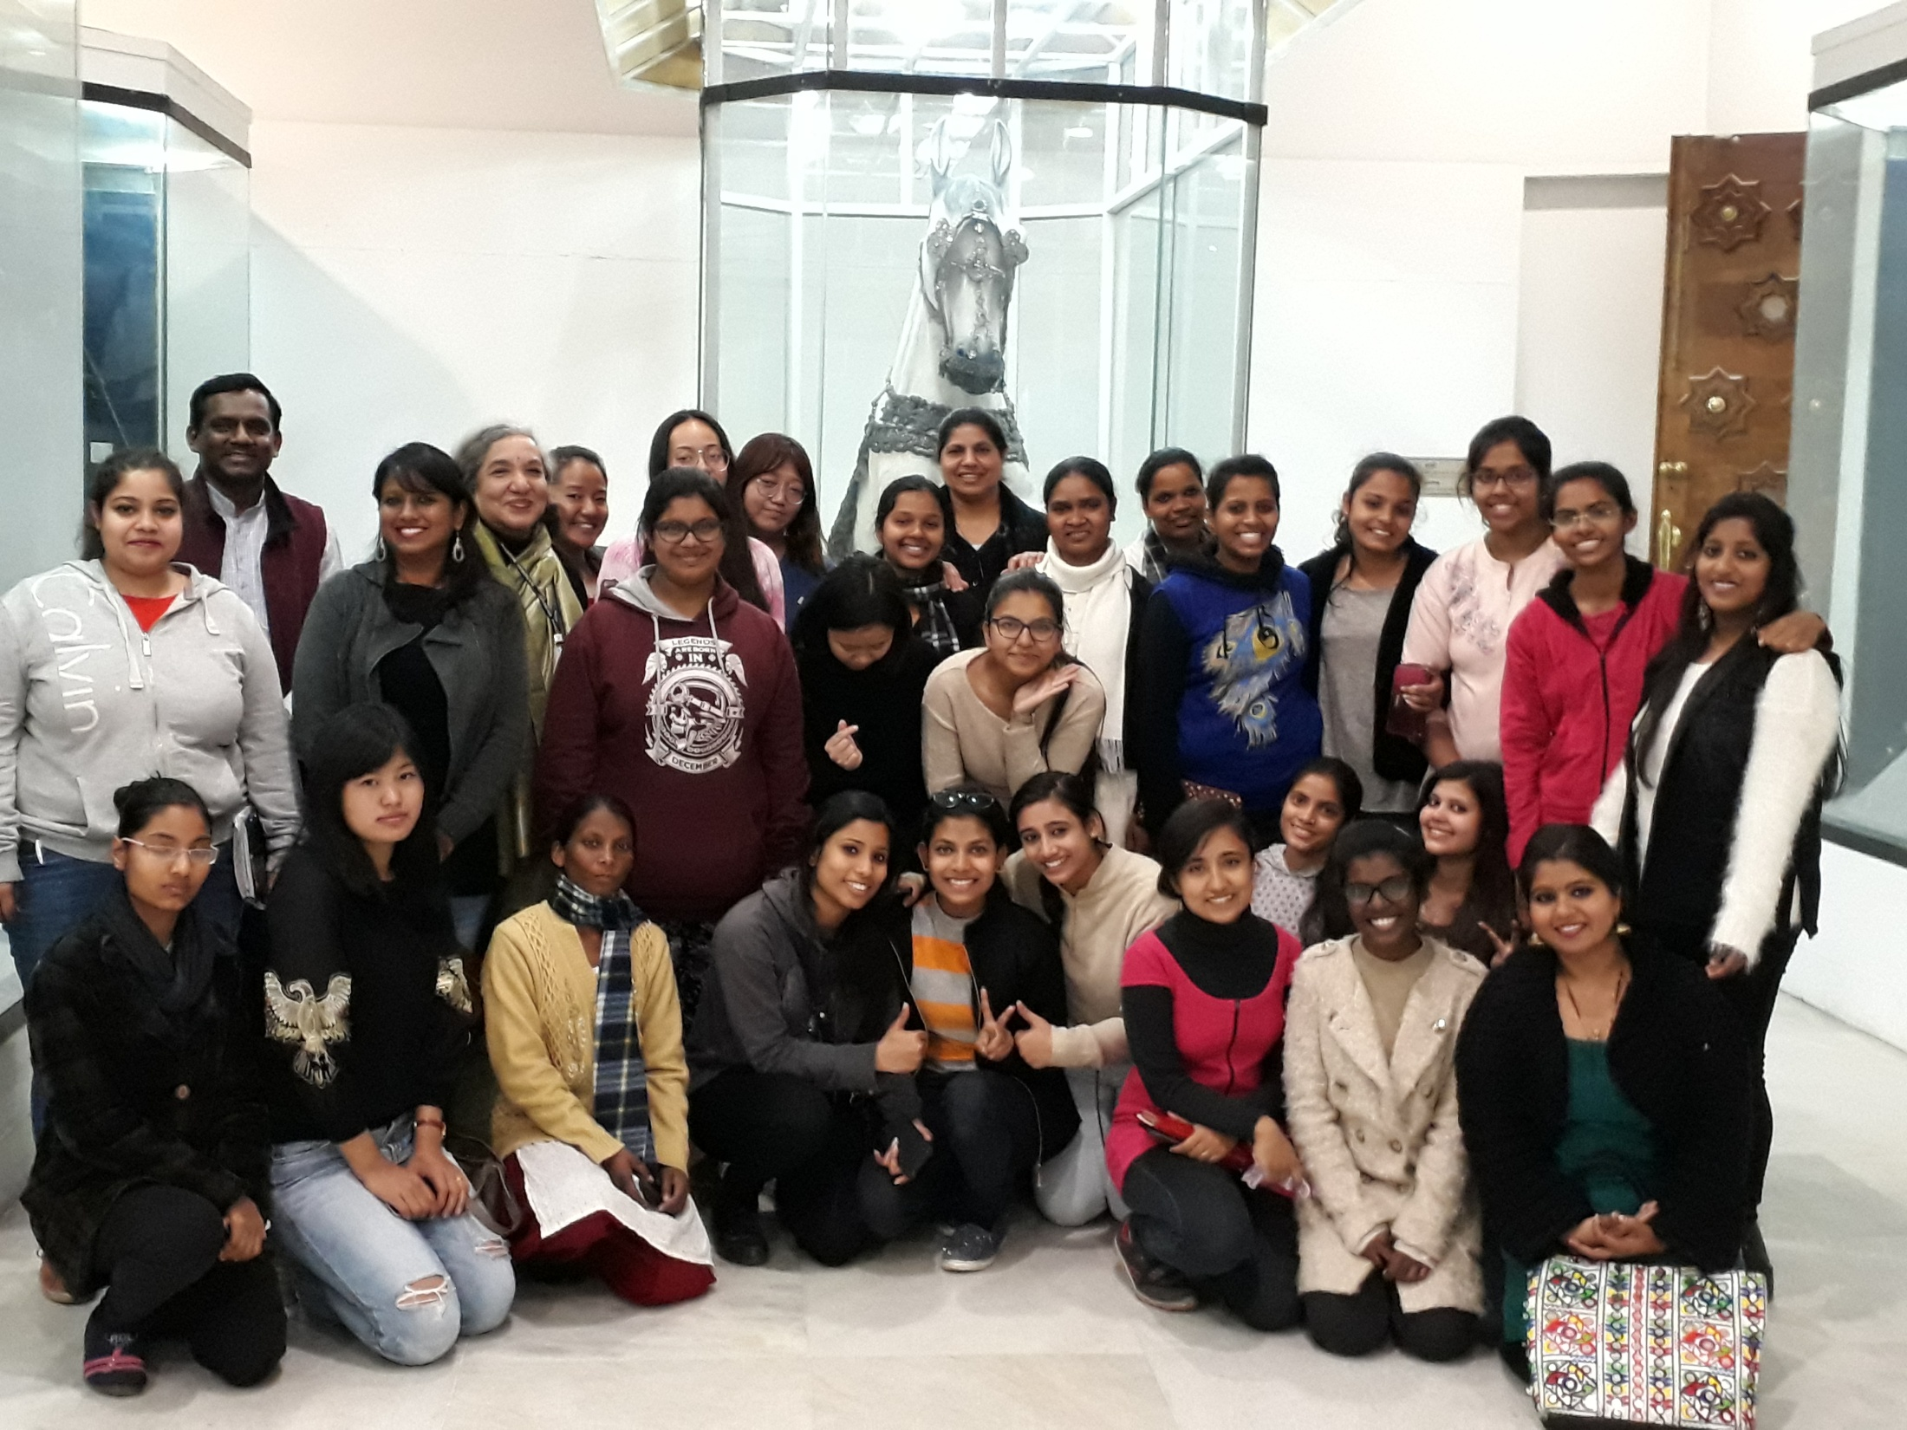
Outreach activities
Clothes and Books Donation Campaign organized in collaboration with the NGO, Pahal, in March-April 2018
Teach-ins organised by department faculty for school children on topics of historical value in consonance with their school syllabus and to develop interest in the discipline of history: In the Pipe-line

Slide 22
S.w.o.c. analysis
Strengths | Weaknesses | Opportunities | Challenges
Highly-qualified faculty with national/international publications | Need for multimedia facilities for departmental use and archival projects | Starting an MA History Programme | Students preferring courses in science, commerce etc over History for immediate and better placements
Participation of faculty in college and university administration/ activities | Inability to execute longer study tours in an academic year | Ongoing Oral History Project and Making of an Oral History Archive | Most students admitted into the department are from disciplines other than history
Department Room and Deptt Library |  | Institutional Collaboration at departmental levels
Receptivity, inter-personal communication and mentorship to the students
Imparting of Hindi-medium instruction where required (For example, GE papers)

Slide 23
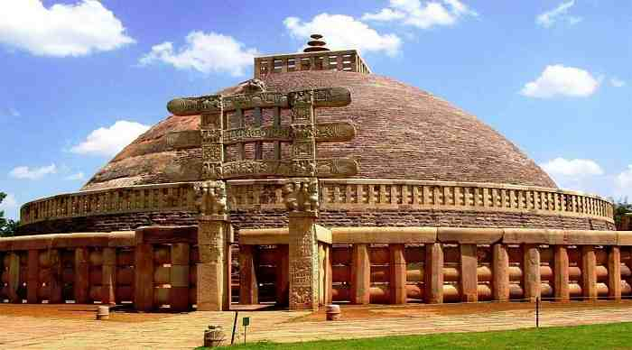
Future plans
M.A. course in History
An edited volume by faculty members on Culture, Society and Education
Teach-ins by faculty members for school children
Regular Alumni Meets
National Seminar either in collaboration with NMML or with funding from UGC/ICSSR/ICHR

Slide 24
Thank You !!!

